Slide 1
Freedom Friday
Sergiu Enache
Data consistency in serverless computing

Slide 2
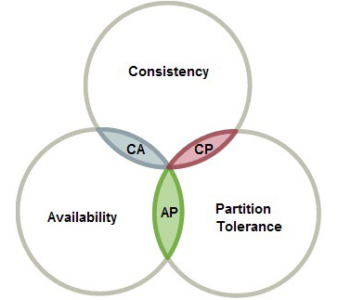
Data consistency options
Traditional ACID transactions
Atomicity, consistency, isolation and durability
Monolithic database which is the single truth
Two phase commit (anti-pattern)
ACID is mandatory
CAP Theorem: Choosing consistency
Eventual consistency
Compromises ACID, BASE (Basically Available, Soft state, Eventual consistency)
CAP Theorem: Choosing availability
Saga Pattern
Trading atomicity for availability and consistency

Slide 3
Eventual consistency
Availability over consistency
Avoid resource locking
Ideal for long running transactions
Race conditions
Data replication
Event based
Actions raised as events
Messages using message brokers

Slide 4
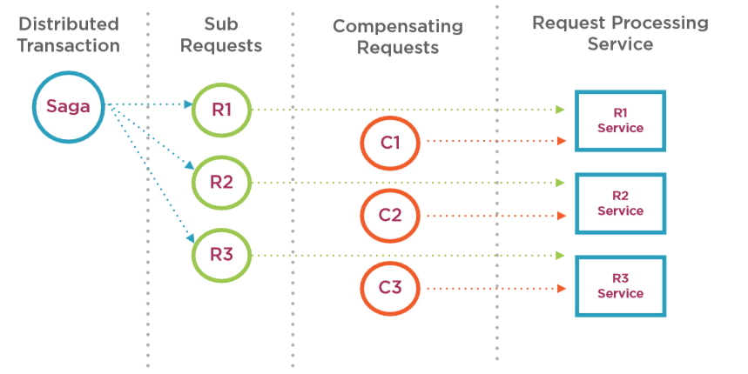
Saga Pattern
Trading atomicity for availability and consistency
Transaction split into many requests
Track each request
First described in 1987
Failure management pattern
Compensate requests when one service fails
Implementation
Saga log
Saga execution coordinator (SEC)
Requests and compensation requests

Slide 5
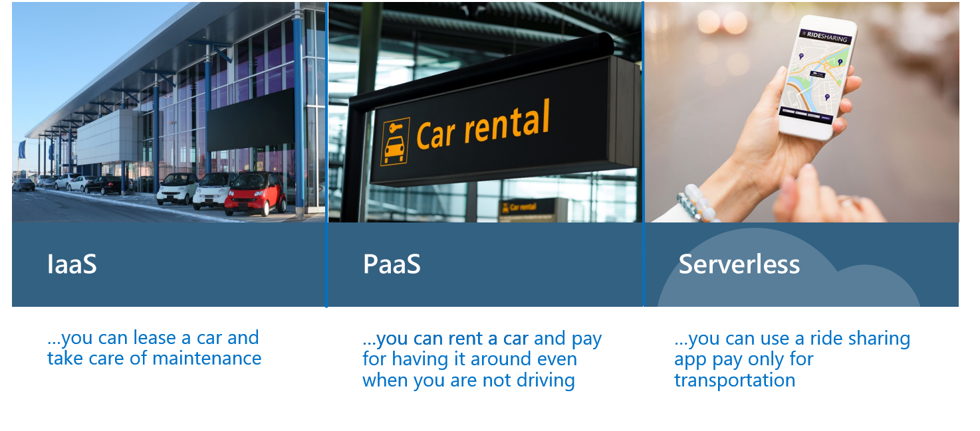
.. If cloud computing was transportation (Build 2018)

Slide 6
Tell us about your team
<Team name>
Which office (s) are you in?
What have you built?
Who is on your team
Name | Role | I usually work on…
Sergiu Enache | Developer | Open Integration project (WKUK)

Slide 7
Tell us about your solution
What was your inspiration?
What problem are you solving or benefit are you delivering?
What does it do?
Does it integrate to an Access product?
Why will we and our customers love your Work?
Remember to record a 2 – 3 minute video and upload it, and this PowerPoint to unique folder on this collaborate site:
https://go.accessacloud.com/app/collaboration/workspace/index/ce4380dfcef34241b52f15d8f106d9fe/

